Slide 1

Earth’s Features
Experience 4
Earth Events
https://sites.google.com/wflboces.org/boces4science/home
Grade 2

Slide 2
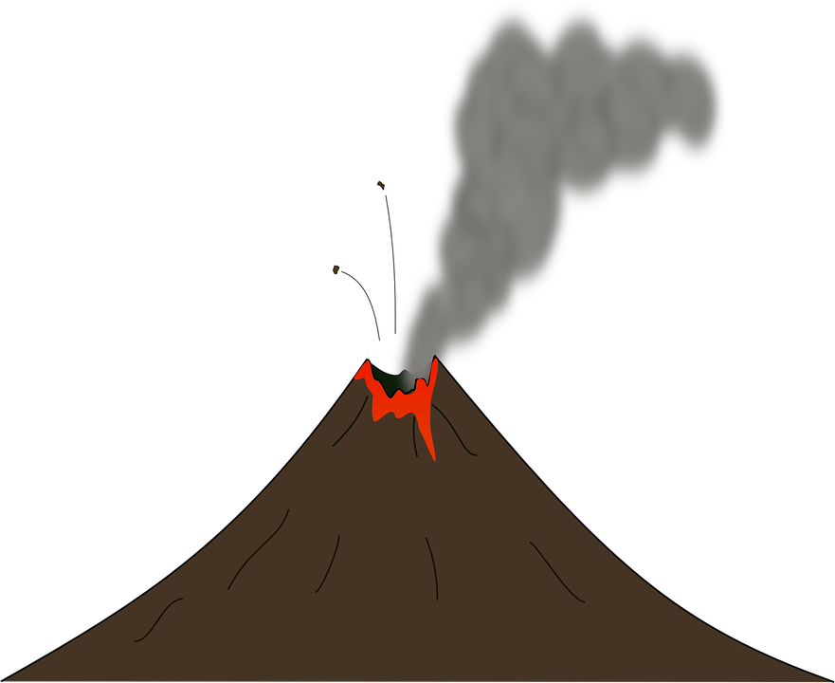
What are earth events?
Earth Events are events that happen on Earth due to natural causes.
  Some events include hurricanes, earthquakes, tornadoes, eruptions, mud/landslides, floods, tsunamis, blizzards and other storms, mountain building due to plate tectonics and more.
  Some events that are not Earth events include growing up, losing baby teeth, watching a movie, walking, talking, buying food, talking on the phone and more.

Slide 3
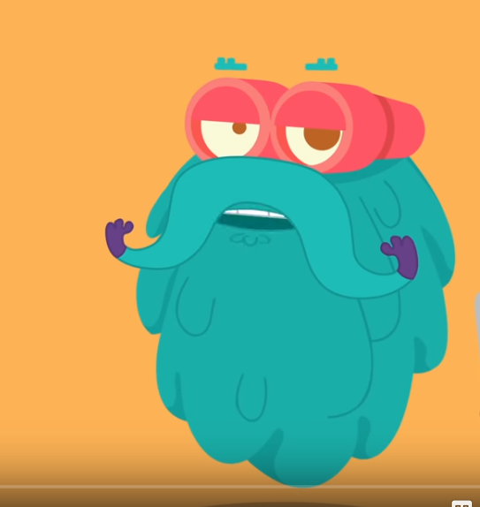
Learn about earth events
Students can learn about different Earth events.
  Dr. Binocs has several individual videos about different events:
    https://www.youtube.com/watch?v=HaEmIakO7f4 - compilation of events
    https://www.youtube.com/watch?v=dJpIU1rSOFY – Earthquakes
    https://www.youtube.com/watch?v=MfsugkikLJI&t=48s – Tsunami
    https://www.youtube.com/watch?v=EpuDYZ_g0yg –Tornadoes
    https://www.youtube.com/watch?v=J2__Bk4dVS0 – Hurricanes
    Pick an Earth event, learn about it, draw it, write about it
    Have students look back at their model. Where would they put a house on their model?
    Have students think about what would happen to their house on the model if the Earth event they studied happened there.
    Have students think about how they could protect their house.

